Slide 1
Use Case Diagrams
Edited by R.A. Mustafa Büyükkeçeci from various UML resources.

Slide 2
Use Case Diagrams Overview
Definition: A use case diagram is a form of requirements modelling. They provide a graphical presentation of the desired system’s functionalities which will be performed by the actors.
UML Diagram Type: Behavioural.

Slide 3
Use Case Diagrams Overview - 2
Use case diagrams describes:
the high-level functions (functional requirements),
the scope of a system, and
the interactions between the system and its actors (users).
Use case diagrams illustrate and define the context and requirements of either an entire system or the important parts of the system.
Therefore, you can model a complex system with a single use case diagram, or create many use case diagrams to model the components of the system.

Slide 4
Use Case Diagrams Overview - 3
Although the use cases and actors in use case diagrams describe what the system does and how the actors use it, they do not describe how the system operates internally (thread system as black box).
Use cases represent sequences of actions carried out by the system and actors represent the people or other systems that may interact with the system being modelled.
Use cases are created during the early stages of a project to model what happens in the existing system (if there is one), or to model the new system that is going to be developed.

Slide 5
Use Case Diagrams Overview - 4
Producing use case diagrams and the associated document is an analysis technique rather than a design technique.
Analysis: is understanding the problem you're trying to solve. Use case, activity diagram, etc.
Design: is figuring out how to organize the solution once you've done the analysis and understand the problem. Class diagram, sequence diagram, state diagram, etc.
When you identify and organize use cases, you must identify whom the system is for (your customer) and who uses the system (the users or actors).
The users and the customers are generally not the same group of people. Even when they are the same people, it’s beneficial to think of user and customer as different roles.

Slide 6
Use Case Diagrams Overview - 5
Stakeholder Group | Definition
Customers or clients | Customers or the clients are the people or organizations that ultimately fund and task your team. You and your team may have a contractual relationship with them (external customers), or they may be part of your own management structure (internal customers).
The client’s customers | These are the people or organizations that buy things from your client.
Users or actors | When you refer to users of a system, they may be your clients’ customers, or they may be workers in your client’s organization who have a hands-on relationship with the system. Many systems have users of all types – clients, their customers and workers.

Slide 7
Use Case Diagrams Overview - 6
Imagine you’re building a hotel registration system to be used by both potential guests from home via internet, and by registration clerks at the hotel when the potential guests phone them. The main stakeholders and their roles on this project are:
Stakeholder Group | Example | Roles
Customer/Client | Hotel Chain | -
Customer’s customers | Potential Guest | -
Actor | Registration Clerk | Make, change and confirm reservations.
 | Potential Guest | Reserve room or other facilities. Change and cancel reservations.
 | Managerial Staff | Configuration for rooms, prices, check-out policies.
 | Credit Card AUTH System | Get payments. Send refunds.

Slide 8
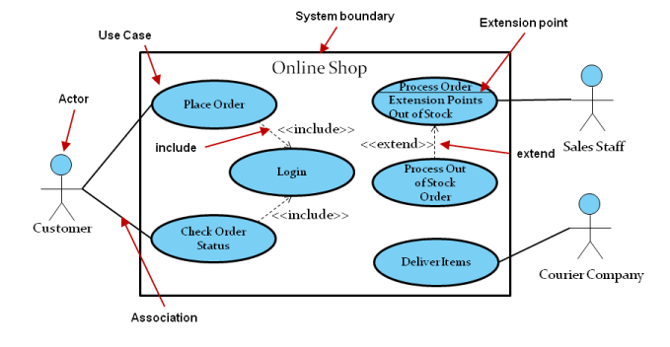
Use Case Diagrams Overview - 7

Slide 9
An Actor
An actor is a person or system that derives benefit from and is external to the subject.
It is depicted as either a stick figure (default) or, if a nonhuman actor is involved, as a rectangle with <<actor>> in it (alternative).
Actors are labeled with its role.
Actors are allowed to associate with other actors only using a specialization/generalization association (superclass), denoted by an arrow with a hollow arrowhead.
Actors have to be connected only to use-cases.
Actors can also communicate through use cases.
Associate each actor with one or more use cases.

Slide 10
An Actor - 2
Actors may be an organization, a machine, or another external system.
Actors are placed outside the subject/system boundary.
Actors are very much like classes, so you should use singular, business relevant nouns (i.e. student, teacher, booking system) to name human actors.
Do not use proper nouns (i.e. Sam, John, Bob, C-3PO…etc.).
When naming the nonhuman actors, you can use the name of the role that the hardware or external system performs relative to your target system (i.e. Online Payment Service).
Not all stakeholders will be actors.

Slide 11
How to Find Actors?
These questions are useful in identifying actors:
Who will supply, use, or remove information from the system?
Who will use the system?
Who is interested in a certain feature or service provided by the system?
Who will support and maintain the system?
What are the system's external resources?
What other systems will need to interact with the system under development?

Slide 12
A Use Case
Once you have captured an initial set of actors that interact with your system, you can assemble the exact model of those interactions.
The next step is to find cases where the system is being used to complete a specific job for an actor – use cases, in fact.
Use cases can be identified from your user’s requirements (functional ones).

Slide 13
A Use Case - 2
A use case typically represents a major piece of system functionality (functional requirements).
A use case, or job, can extend or include another use case.
Don’t forget use-case-generalization, which is a relationship from a child use case to a parent use case.
They are placed inside the system boundary and labelled with a descriptive verb-noun phrase.
Use cases should not be open be ended. E.g. “Register” instead should be named as “Register New User”.
Name use cases using domain terminology.

Slide 14
How to Find Use Cases?
The best way to find use cases is to consider what each actor requires of the system.
For each actor, human or not, ask:
What are the goals that the actor will attempt to accomplish with the system?
What are the primary tasks that the actor wants the system to perform?
Will the actor create, store, change, remove, or read data in the system?
Will the actor need to inform the system about sudden external changes?
Does the actor need to be informed about certain occurrences, such as unavailability of a network resource, in the system?
Will the actor perform a system startup or shutdown?

Slide 15
A System Boundary
Although there is an implicit separation between actors and use cases that marks your system’s boundary, UML does provide another small piece of notation if you want to make things crystal clear.
The rectangle around the use cases is called the system boundary box and as the name suggests it indicates the scope of your system - the use cases inside the rectangle represent the functionality that you intend to implement.
System boundary provides use case containment behaviour.
It includes the name of the system inside or on top (default).

Slide 16
Association Relationship
An association (aka communication line) is a connection between an actor and a use case.
The purpose of an association relation is to show that an actor is simply involved in a use case, not to imply an information exchange in any particular direction or that the actor starts the use case.
Several actors at one use case mean that each actor can carry out the use case on his or her own and not that the actors carry out the use case together.
There is no theoretical limit to the number of actors that can participate in a use case.

Slide 17
A Generalization Relationship
A generalization relationship has an arrow drawn from the specialized use case or actor to the base use-cases or actors.
It is possible to generalize both use cases and actors.
Use case generalization refers to the relationship which can exist between two (can be more than two) use cases and which shows that one use case (child) inherits the structure, behaviour, and relationships of another actor (parent).
Actor generalization refers to the relationship which can exist between two (can be more than two) actors and which shows that one actor (descendant) inherits the role and properties of another actor (ancestor).

Slide 18
Generalized Actors and Use-Cases
Ancestor Actor
Parent Use Case
“is-a” relationship
“is-a” relationship
Payment
User
Pay by Credit Card
Pay by Cash
Pay by EFT
Child Use Cases
Admin
Guest
Descendant Actor

Slide 19
Include and Extend Relationship
Include (uses) relationship is a directed relationship between two use cases, which implies that the behaviour of the included use case is inserted into the behaviour of the including use case.
The keyword <<include>> is written in guillemets alongside the relationship arrow.
An include dependency is formerly known as a “uses” relationship in UML v1.2 and earlier.
Extend is a relationship between two use cases, which specifies how and when the extended use case insert the behaviour defined in the extending use case.
The keyword <<extend>> is written in guillemets alongside the relationship arrow.

Slide 20
Include and Extend Relationship - 2
Withdraw Money
<<include>>
Correct PIN
<<uses>>
Withdraw Money
<<extend>>
Print Receipt

Slide 21
Summary of Associations
 | Use Cases | Actors
Generalization Between | Yes | Yes
Include Relationship Between | Yes | No
Extend Relationship Between | Yes | No
Association Between | No | No
An association is a connection between an actor and a use case and indicates that an actor can carry out a use case.

Slide 22
Key Points
Name a use case with a verb-noun phrase that states the actor's goal (i.e. “Generate Report”).
Use cases should not be open be ended (i.e. “Register” instead should be named as “Register New User”).
Actors should be named with a singular, non-proper (common), business relevant nouns.
Do not violate association rules (please check slide #21).
Do not show non-functional requirements.
Do not try to model GUI.
Do not add architectural details to your models.
Use case diagram does not show sequence or parallel case(s).
Try to use the correct level of details. Do not drown in details.
Try to think simple.

Slide 23
How Many Use Cases Should Your Model Have?
There is no set rule for the number of use cases that your use case model should contain for a given system.
The number of use cases depends on the jobs that your system has to do according to the requirements.
This means that for a particular system, you might only need two use cases or you might need hundreds.
It is more important that you have the right use cases, rather than worrying about the amount you have.
As with most things in system modelling, the best way to get your use cases right is to get used to applying them; experience will teach you what is right for your system.

Slide 24
What Makes a Good Use Case?
Experience will help you determine when you have a good use case, but there is a rule of thumb that can be used to specify a use case:
A use case is something that provides some measurable value/result to the user or an external system (actor).
Any piece of system behaviour that meets this simple test is likely to be a good candidate for a use case.

Slide 25
Reading Use Case Diagrams
Check-in Process
3
1
Check-in
2
4
Express Check-in
Check-in Employee
Passenger
IT System
Business System

Slide 26
Reading Use Case Diagrams - 2
According to your interest, you can start reading a use case diagram with the actor or with the use case.
Starting with the actor check-in employee you can find associations between the two use cases check-in and express check-in.
This means that persons who interact with the IT system as check-in employees can carry out the use cases check-in and express check-in.

Slide 27
Reading Use Case Diagrams - 3
For the readability of the diagram it makes sense that use cases are located one below the other, however this means nothing.
A meaningful order in which a worker carries out use cases cannot be documented in a use case diagram.
Unless the use case diagram has to be amended, the use cases check-in and express check-in are everything that a check-in employee can do with the IT system.

Slide 28
Reading Use Case Diagrams - 4
The actor passenger has an association to the use case express check-in, which means that people who interact with the IT system as passengers can carry out the use case express check-in directly with the IT system.
The actor check-in employee also has an association to the use case express check-in, which means that both passengers and check-in employees can carry out this use case.
It does not mean that these two work together during express check-in.

Slide 29
Reading Use Case Diagrams - 5
Of course, during the use case check-in too, a passenger checks himself or herself in and not an employee, but actor of the IT system is always the one who directly interacts with the IT system.
For the use case express check-in this can be either the passenger, who, with his or her plane ticket, can obtain a boarding pass at a machine, or a check-in employee who can do this in place of the passenger.
However, for the business system the passenger is always the actor, because he or she is located outside the business.
The employee, on the other hand, is not an actor from the perspective of the business system, because he or she works inside the business system.

Slide 30
Business Use Case Diagrams
Business use case diagrams represent business function, process, or activity performed in the modeled business.
i.e. get a new driving license, to pay an invoice, join a tour.
They contain the business actor, the business use case(s) representing the relevant parts of the business and any supporting business actor(s) if there is any.
A business actor, i.e. tour guide, guest, driver candidate, passenger, represents a role played by some person or system external to the modeled business, and interacting with the business.

Slide 31
Business Use Case Diagrams - 2
A business use case is described from the actor's perspective.
All association rules and types mentioned previously can be used in business use case diagrams.
Both business use case as well as business actor are not defined in UML standard, so you will either need to use some UML tool supporting those or create your own business modeling stereotypes.

Slide 32
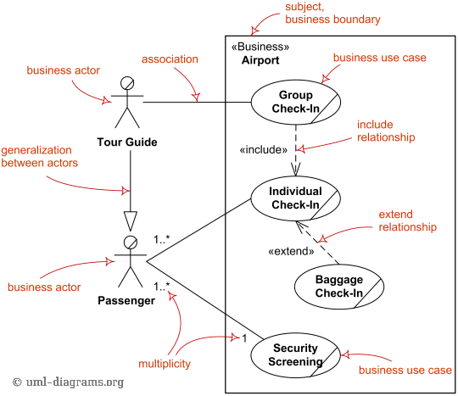
Business Use Case Diagrams - 3
Check for more: http://www.uml-diagrams.org/use-case.html#business-use-case

Slide 33
System UC Vs. Business UC
Aspect | Business Use Case | System Use Case
Who is the primary actor? | Mainly a business actor, e.g. customer, or other external party, e.g. shareholder, or an internal party, e.g. manager. | Mainly a human user who initiate system behavior, or another system, e.g. scheduler.
What is the use case for? | Something the actor wants to get done by using the business/organization. | Something the actor wants to get done by using the system/application.
What does it describe? | Describes an interaction involving the primary actor, the relevant parts of the business, and any supporting actor(s), in terms of their business behavior. | Describes an interaction involving the primary actor, the relevant parts of the system, and any supporting actor(s), in terms of their system behavior.

Slide 34
Use Case Summary
The main purposes of producing use cases are as follows.
They provide a high-level view of what the system does and who uses it.
Use cases are used to model sequences of actions that are carried out by the system and that provide an observable result to someone or something outside the system, known as an actor.
They can be used to model alternative scenarios for specific use cases that may result in different sequences of actions.
They use a simple diagrammatic notation that is comprehensive to end users and can be used to communicate with them about the high-level view (overview) of the system.
They can be used to validate/verify requirements.
They can be used to define clear boundaries of a system.
They can be used to link stakeholder needs to system requirements.

Slide 35
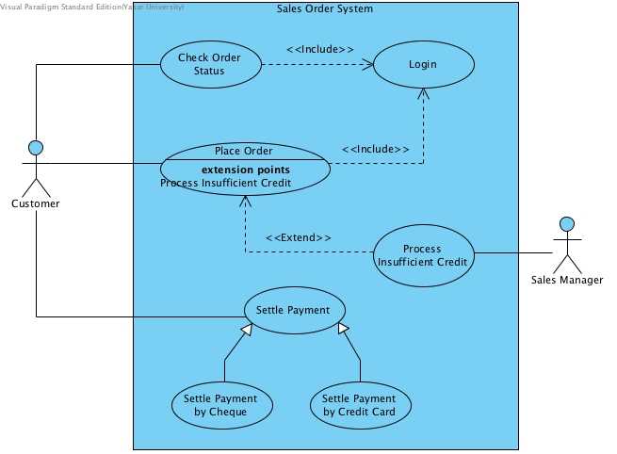
Use-Case Diagram Examples

Slide 36
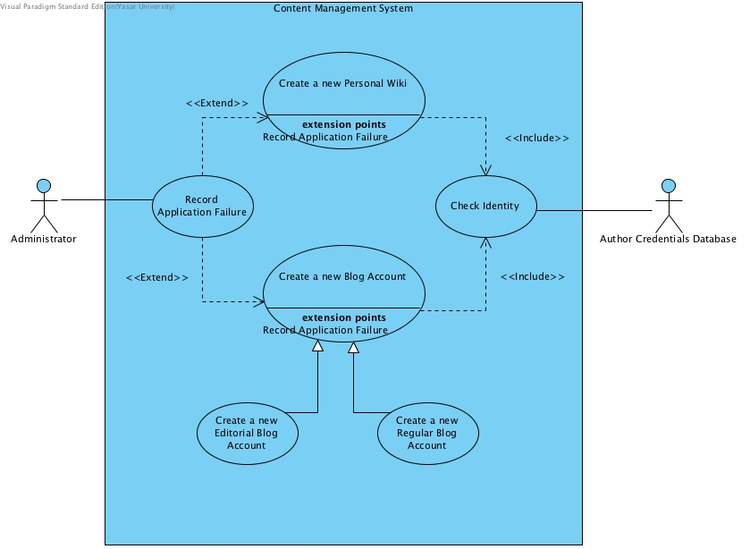
Use-Case Diagram Examples - 2

